Slide 1

Uses of Generative Artificial Intelligence in Research Administration: Good, Bad and Ugly
AnnMaria De Mars, The Julia Group
Michael Selburg, Turtle Mountain College
Jeanette Vega, The College of New Jersey
Sandra Justice, Lawrence Technological University

Slide 2
The Problems
University research administrators report an overwhelming workload and a high degree of burnout
Result: Negative impact on staff retention
Notes:
University research administrators report an overwhelming workload and a high degree of burnout (Strom, 2024; Tabakakis et al., 2020). These challenges are not only personal but also impact the institution, as workload and stress have a negative impact on staff retention (Woodward & Evans, 2025).

Slide 3
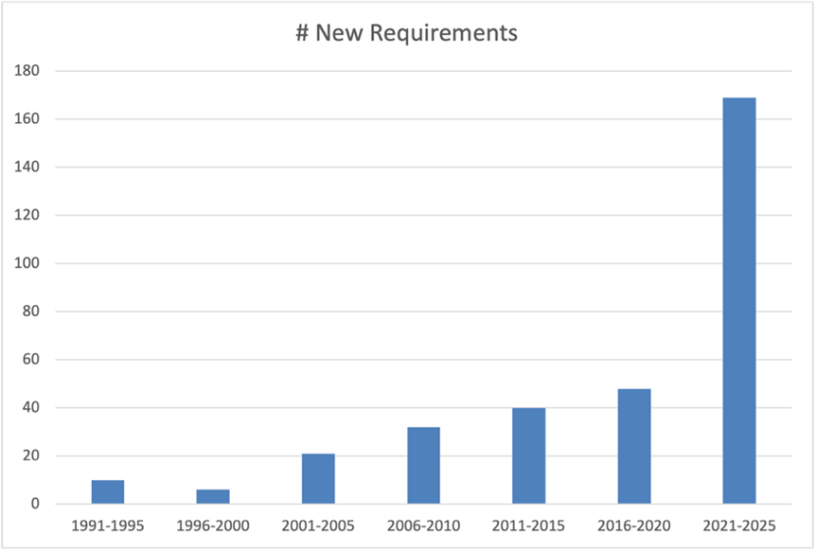
Problem is getting worse!
Percentage of time that PIs spent on research administration has increased from 42% to 44%
Field is becoming more complex.
Notes:
From 2012 to 2018, the percentage of time that PIs estimated they spent on research administration rather than conducting active research increased from was 42% to 44% (Schneider, 2020). The field is only becoming more complex. From 1991 to 2025, the Council on Governmental Relations (2026), identified 326 new or updated federal requirements,

Slide 4
Problem is even worse
More Principal Investigators under pressure to increase external funding, who expect more administrative support
University budgets contracting through reductions in student enrollment.
Emerging research institutions (ERIs) like tribal colleges and universities, are subject to the same compliance requirements as major research universities without the larger infrastructure of R1 institutions.
Notes:
Research administrators are squeezed between Principal Investigators under pressure to increase external funding, who expect more administrative support (Schiller and LeMire, 2023) and university budgets which are contracting through reductions in student enrollment. This pressure is an even greater challenge for emerging research institutions (ERIs) which are subject to the same compliance requirements as major research universities without the larger infrastructure of R1 institutions.

Slide 5

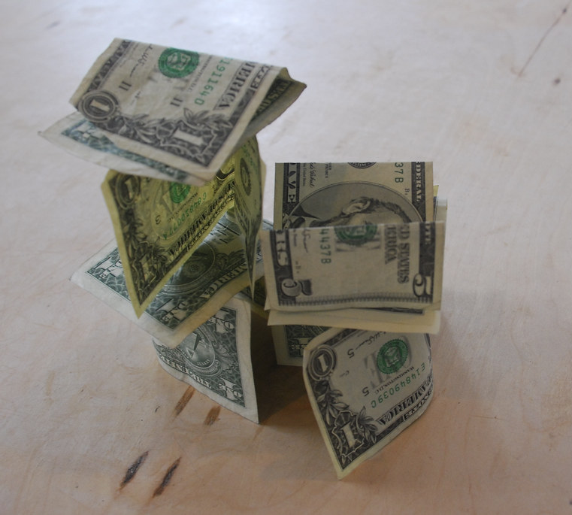
How do we do more with less resources?
This Photo by Unknown Author is licensed under CC BY

Slide 6

Could generative AI be the solution?
Maybe.

Slide 7
Adoption of generative AI
As of 2025, across all industries, 62% percent of organizations using AI stated they were at the experimental or piloting stage
Of the one-third that reported scaling AI integration, nearly all were doing so for only one or two business functions
With the return on investment still uncertain, ERIs are reluctant to risk significant resources in scaling this new technology
Notes:
Generative artificial intelligence offers one possible solution, but its adoption is still in the early stage. As of 2025, across all industries, 62% percent of organizations using AI stated they were at the experimental or piloting stage and of the one-third that reported scaling AI integration, nearly all were doing so for only one or two business functions (Singla et al., 2025). With the return on investment still uncertain, although there is potential benefit in increasing productivity in research administration, ERIs are reluctant to risk significant resources in scaling this new technology (Ruediger et al., 2026). I

Slide 8
More concerns than cost
Data security
Ability to comply with legal standards increase research administrators’ skepticism of artificial intelligence applications.
  in 2024, there were 59 new AI-related regulations introduced from 42 agencies, double the number in 2023
“Hallucinations”, that is, false responses.
  Shojaee et al. (2025) found that both large language models and large reasoning models completely collapse under conditions of high complexity.
Notes:
In addition to cost issues, concerns regarding data security and ability to comply with legal standards increase research administrators’ skepticism of artificial intelligence applications. This skepticism is well-placed; in 2024, there were 59 new AI-related regulations introduced from 42 agencies, double the number in 2023 (Maslej et al., 2025). Compounding issues of cost, privacy and regulations is the problem of “hallucinations”, a euphemism for false responses. Shojaee et al. (2025) found that both large language models and large reasoning models completely collapse under conditions of high complexity. With problems of low complexity, LLMs had a near 100% of accuracy with a high token budget, with medium complexity. problems, the probability of a correct response dropped to 20% and with highly complex problems, to near zero.

Slide 9

AI Users are Confidently Wrong
Users provided with incorrect information produced by generative AI were significantly less likely to respond that they didn’t know the answer than when AI was unavailable. With AI available, respondents expressed greater confidence in their answers, gave a far greater proportion of incorrect answers.
Notes:
Research suggests that lack of skepticism of results of generative artificial intelligence can be problematic. Marcoccia, Quattrociocchi and Capraro (2026) found that participants provided with incorrect information produced by generative AI were significantly less likely to respond that they didn’t know the answer than when AI was unavailable. With AI available, respondents expressed greater confidence in their answers, gave a far greater proportion of incorrect answers. They were more often confidently wrong.
[Visual source: AI-generated conceptual pictogram, added for illustration. Not a factual depiction.]

Slide 10

Generative artificial intelligence can be the solution when intelligently applied.
Experienced administrators have advocated for information on specific use cases for generative artificial intelligence
Notes:
Generative artificial intelligence can be the solution to excessive and increasing demands on research administrators, when intelligently applied. In panel discussions, experienced administrators advocated for information on specific use cases for generative artificial intelligence (Ruediger et al., 2026). Hence - this session
[Visual source: AI-generated conceptual pictogram, added for illustration. Not a factual depiction.]

Slide 11

TaMPER framework proposes five steps in effective AI use in research administration
Defining the task,
Selecting a model,
Prompting,
Evaluation
Reporting (AI for Research Administration, 2026).
Notes:
The TaMPER framework proposes five steps in effective research administration; defining the task, selecting a model, prompting, evaluation and reporting (AI for Research Administration, 2026). l was used.
[Visual source: AI-generated conceptual pictogram, added for illustration. Not a factual depiction.]

Slide 12

Model Selection
Models used in the following examples were Gemini Pro 3.1 and Microsoft Copilot, which relies on GPT 5.1 /5.2.
Research administrators rarely compared models; they selected models licensed by their institutions.
Notes:
Even though this was listed in the TaMPER framework as #2, Except where noted below, models used were Gemini Pro 3.2 and Microsoft Copilot, which relies on GPT 5.1 /5.2. These models were chosen as those licensed by our respective institutions.
[Visual source: AI-generated conceptual pictogram, added for illustration. Not a factual depiction.]

Slide 13
Our sample
University of South Florida: R1 Institution with 49,622 students, 3,565 faculty and research staff
The College of New Jersey: Primarily Undergraduate Institution with 8,141 students, 755 faculty
Turtle Mountain College: Tribal College with 872 students, 51 faculty
Notes:
We present applications of AI at three institutions; a tribal college, primarily undergraduate institution and a large R1 university

Slide 14

Generative artificial intelligence (AI) can be summarized into four broad categories.
“AI-assisted programming”
Digital intern
AI Tutor
“Human in the loop required
Notes:
Across the three institutions, exploration of uses of generative artificial intelligence (AI) can be summarized into four broad categories. Effective examples fit into four categories:
“AI-assisted programming” of “write once, run forever” programs: Write code to automate tasks, e.g., time and effort reporting and qualitative data collection for progress reports. This is not ‘create a macro’, but rather, requires multiple prompts and knowledge of both data and task requirements. We distinguish between AI-assisted coding and vibe-coding, not having found the latter to be effective.
Digital intern: automation of clerical tasks such as creating a reference list, formatting statistical output into a desired report format or creating graphics for publications
AI Tutor: NotebookLM was used for training, from onboarding new staff to providing PIs a customized AI agent for grants management
“Human in the loop required”: These uses begin with AI but require significant human review, for example, uploading a proposal and request for proposal instructions, then asking for suggestions on topics or sections that need augmentation
[Visual source: AI-generated conceptual pictogram, added for illustration. Not a factual depiction.]

Slide 15

“AI-assisted coding” of Google Apps Scripts and VBA scripts is NOT vibe-coding
Vibe-coding = creating code via AI-prompting and trial and error, without understanding the underlying code.
Notes:
These are programs to handle management tasks, which are written by AI and become part of the research administration process. Vibe-coding is defined as (Fawzy, Tahir & Blincoe, 2025) creating code via AI-prompting and trial and error, without understanding the underlying code. As discussed in a subsequent section, we have not found vibe-coding to be an effective means of increasing productivity in research administration.
[Visual source: AI-generated conceptual pictogram, added for illustration. Not a factual depiction.]

Slide 16

Effective AI- assisted coding
Break research administration needs into small blocks.
Specific prompts,
Detailed knowledge of the task requirements
Basic understanding of the language.
Best done in small blocks
Notes:
Consistent with AI for Research Administration’s (2026) injunction to define the task and Shojaee et al. (2025) results that LLMs fail in highly complex conditions, we found an essential first step in effective AI-assisted coding was to break research administration needs into small blocks. Best practices include specific prompts, a detailed knowledge of the task requirements and a basic understanding of the language. This is best done in small blocks, that is, a program for finding duplicate emails across lists collected at various conferences, another program for finding all of the documents that have been updated or added since the last annual report and writing those filenames and links to a spreadsheet.
[Visual source: AI-generated conceptual pictogram, added for illustration. Not a factual depiction.]

Slide 17

Example 1: AI-assisted coding to write a VBA macro for effort reporting
Task: The VBA macro, GeneratePIEffortCertifications, is designed to automate the creation of individual "Effort Certification" reports for Principal Investigators (PIs). It pulls data from a master list, connects it to project information, and generates a formatted, print-ready tab for every PI found in the data.
Notes:
If you don’t know, now you know, this is an important and time intensive task in research administration, tracking the effort a PI expends on each individual grant , budgeting and paying that appropriately.
[Visual source: AI-generated conceptual pictogram, added for illustration. Not a factual depiction.]

Slide 18
Step by Step breakdown
1. Initialization and Safety Checks
The macro first ensures it has a workbook to work with. It looks for three specific tabs: AWARD, DATA, and PIVOT. If any of these are missing, the macro stops immediately and alerts you. It also sets up "Dictionaries" (internal memory lists) to keep track of PI names and project numbers.
2. Building the Award Lookup
The macro goes to the AWARD sheet. it scans the list of projects (Column D) and the corresponding PI names (Column B). It saves this relationship in its memory so it knows exactly which PI belongs to which project number.
Notes:
Notice the specificity> She lays out the name of each sheet in the worksheet, the exact columns in each sheet. Remember step 2 here. It comes up later.

Slide 19
Step by Step
3. Mapping PIs to the Data
Now the macro moves to the DATA sheet:
It looks for a column labeled "PI." If it doesn't find one, it creates a new column at the end.
It looks at every project number in the data. Using the "Lookup" it built in Step 2, it writes the correct PI's name into that row.
It also keeps a unique list of every PI it encounters so it knows how many individual reports it needs to create later.
4. Refreshing the Pivot Table
Before generating reports, the macro ensures the data is fresh. It identifies the entire range of data on the DATA sheet and updates the Pivot Table located on the PIVOT sheet. This ensures that the summaries used for the reports are accurate and include any new PI information just added.
Notes:
Again, she gives the sheet name and column name. She specifies what to do if a specific column is not found. She doesn’t assume that the AI model is going to apply the lookup from step 2

Slide 20
Step by Step
5. Creating Individual PI Tabs
The macro now loops through the list of unique PIs it found. For each PI, it performs the following:
Clean Name: It creates a sheet name based on the PI's last name, removing illegal characters (like / or *) that Excel doesn't allow in tab names.
Clone Template: It makes a copy of the PIVOT sheet to use as a starting point for that specific PI.
Header Setup: It inserts 7 rows at the top to add professional branding, including the title "TCNJ Time & Effort Certification," a legal disclaimer, and the specific certification period (Start/End dates).
Filtering: It sets the Pivot Table on this new sheet to show only the data for that specific PI.
Calculations: It adds several custom formula columns next to the Pivot Table:
Pay Periods: Calculates work days between dates.
S/B (Should Be) / Variance: Calculates expected vs. actual effort.
Formatting: It applies bold headers, dollar signs for currency, and blue-tinted background colors to the table headers.

Slide 21
Step by Step
6. Final Layout and Cleanup
To finish each individual report, the macro:
Signature Line: Adds a "Signature" and "Date" line at the bottom of the data for the PI to sign.
Page Setup: Adjusts the page to Landscape orientation and ensures it scales to fit on one page wide for easy printing.
Once finished, it displays a "Process complete" message.
Notes:
Can show result – genAI test macro and results

Slide 22

Example 2 AI-assisted coding to write a Google apps script to track documents
The task: A shared Google drive folder contains folders and subfolders that have files related to a project. The research administrator would like a single spreadsheet with name, link and last updated date, including only documents added or updated within a given time frame.
This took 15 prompts
Notes:
The task: A shared Google drive folder contains folders and subfolders that have files related to a project. The research administrator would like a single spreadsheet with name, link and last updated date, including only documents added or updated within a given time frame. This saves substantial time in project evaluation by instantly providing a file with links to all relevant documents to review. The initial program required 15 prompts, but still saved me time. Results include a spreadsheet with document name, URL location and date of last update.
[Visual source: AI-generated conceptual pictogram, added for illustration. Not a factual depiction.]

Slide 23
PROMPT 1: I have a google sheet file that contains data from a Google drive folder with the following fields, Doc #, Name ,Pages, Last Updated, Type, URL , notes . Write a Google app script that will read all the new or updated files in the folder, including in all subfolders and update Name, last Updated and URL and append the data to the existing Google sheet.

Slide 24
Why 15 prompts?
My prompt said to read all of the files and in all subfolders. It did not specify that there could be folders in the subfolders. It was trying to read everything in the subfolders as files and it gave me an error.
My second prompt pasted in the error and Gemini suggested the problem was the folder ID was incorrect (it was not)
PROMPT 6 This is what the script should do: 1. Look in each subfolder in the folder provided for files with a URL that is not already in the sheet. 2. Add a row for each file with data for name, last updated , type and URL 3. If the subfolder has a folder, look in that subfolder for files. 4. This should be recursive, that is, look in subfolders of subfolders if necessary
Notes:
Why 15 prompts? This ties back to the TAMPER first step of defining the task. Why did I run into problems?
My prompt said to read all of the files and in all subfolders. It did not specify that there could be folders in the subfolders. It was trying to read everything in the subfolders as files and it gave me an error.
My second prompt pasted in the error and Gemini suggested the problem was the folder ID was incorrect (it was not)
PROMPT 6 (okay, I skipped a few): This is what the script should do: 1. Look in each subfolder in the folder provided for files with a URL that is not already in the sheet. 2. Add a row for each file with data for name, last updated , type and URL 3. If the subfolder has a folder, look in that subfolder for files. 4. This should be recursive, that is, look in subfolders of subfolders if necessary

Slide 25

Why 15 prompts?
PROMPT 15 After multiple failed attempts at recursive processing, it identified the error being caused by the folder including shortcuts as well as files and folders.
Notes:
PROMPT 15 After multiple failed attempts at recursive processing, it identified the error being caused by the folder including shortcuts as well as files and folders. I wanted those ignored since these were just shortcuts to some of the nested files.
[Visual source: AI-generated conceptual pictogram, added for illustration. Not a factual depiction.]

Slide 26

Key take-aways
NOTHING IS OBVIOUS TO A COMPUTER.
Learn from and save your successful prompts.
Notes:
Key take-aways
NOTHING IS OBVIOUS TO A COMPUTER. As a human, you may think, “Of course I want all of the files in the subfolders as well. If you didn’t specify that, you may not get it. Be specific about the structure of your data. You may not be thinking about type of item, whether it is a file, folder or shortcut as data, but that can make a difference
Learn from and save your successful prompts. You’d think this would be obvious but I don’t always remember to do it.
[Visual source: AI-generated conceptual pictogram, added for illustration. Not a factual depiction.]

Slide 27
The prompt that worked
CONTEXT: I have a google sheet file that contains data from a Google drive folder with ID 1adnnFb5cUT7zjC1h6ALwXFMSl0QRz0XI. The Google sheet contains the following fields, Doc # which is the number of the document in the sheet, Name ,Pages, Type, Last Updated, URL , notes . The folder contains files, folders and shortcuts. The subfolders contained within folder 1adnnFb5cUT7zjC1h6ALwXFMSl0QRz0XI may contain both folders and files. Those folders, in turn, may also contain folders and files.
PROMPT
1: Write a Google app script that will read all the new or updated files in the folder with ID 1adnnFb5cUT7zjC1h6ALwXFMSl0QRz0XI, including in all subfolders and update Doc # , Name, Pages, Type, last Updated and URL and append the data to the existing Google sheet. Ignore shortcuts. Look in each subfolder in the folder provided for files with a URL that is not already in the sheet.
2. Add a row for each file with data for name, last updated , type and URL
3. If the subfolder has a folder, look in that subfolder for files.
4. This should be recursive, that is, look in subfolders of subfolders if necessary
Notes:
All of the specifics I added after the first prompt

Slide 28
Example 3: AI-assisted coding Google app to eliminate sending duplicate emails
Task: We have multiple files of emails collected at different events, from web-based forms. Sending out a notice of funding opportunity or request for clinical trials participation, we don’t want the same person to get multiple emails.
A Google apps script was written to remove duplicates across files. Because I don’t trust AI implicitly, I had the script highlight the duplicates in AI in red.
Also, I deliberately entered two duplicate IDs in a file to test whether the program was working and put the files with the duplicates and then a couple of other small test files in a folder. If the program was working, it would show only those two duplicates.
Notes:
A Google apps script was written to remove duplicates across files. Because I don’t trust AI implicitly, I had the script highlight the duplicates in AI in red.
Also, I deliberately entered two duplicate IDs in a file to test whether the program was working and put the files with the duplicates and then a couple of other small test files in a folder. If the program was working, it would show only those two duplicates.
Then, an intern sorted the master file by ID and deleted anything in red after manually checking.

Slide 29

Key take-away
Test Early. Test often.

Slide 30
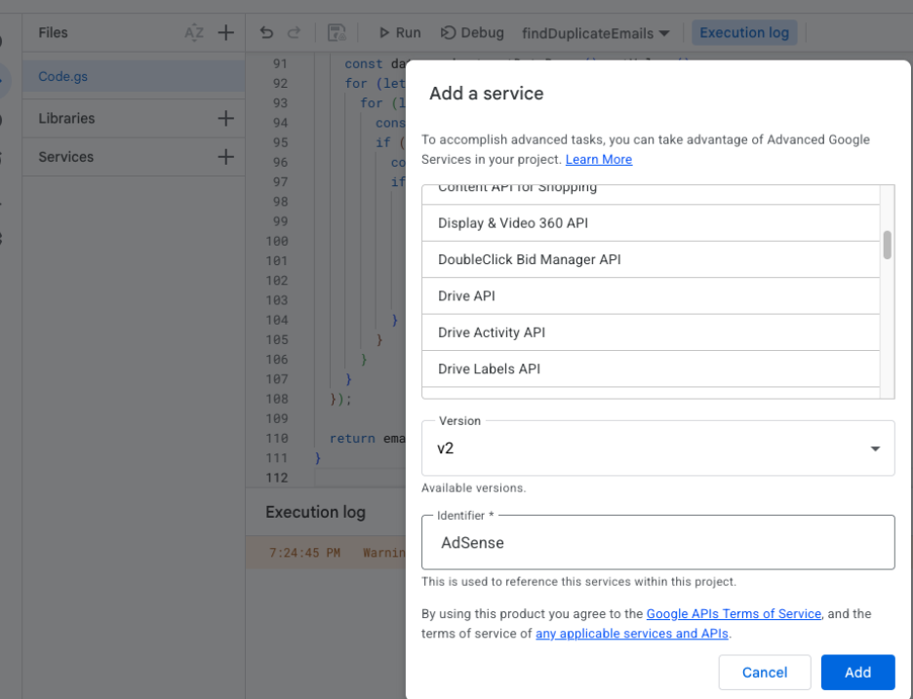
Example 4: AI-assisted debugging a Google apps
Drive API updated & still not working
Issue: pop-up alert was blocked
Fixed, but …
Notes:
AI can also be used to debug programs. Code didn’t run exactly forever. When running it after a few months, I received an error which took one prompt to fix. I pasted in the code and the error - Critical Error: Drive is not defined.
It took 30 seconds to fix this. The Drive API had been updated and I needed to add the service.
However, it still was not working. I pasted in an error the second time and was able to identify the issue is that it was trying to create a pop-up alert, which was blocked. I changed the code and it worked.

Slide 31
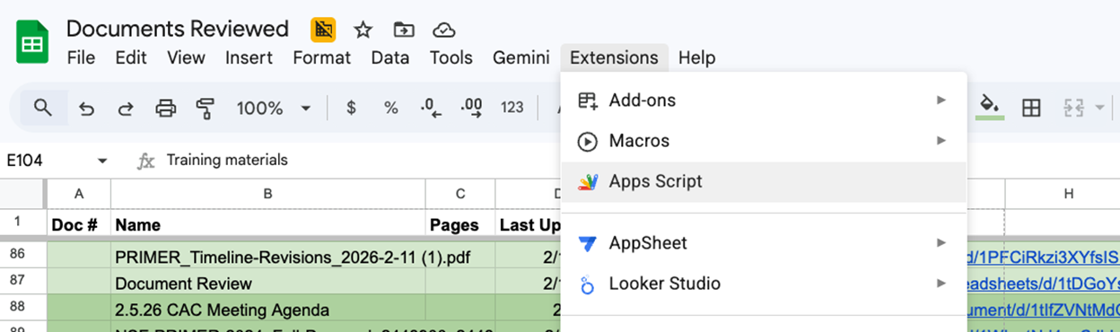
WHY did the code quit working?
The first several times I ran this code, I ran it directly from the spreadsheet by selecting apps script. The latest time I ran it, I ran it as a stand-alone, just open the script.
Notes:
I mention this because a common criticism of AI-generated code is how difficult it is to de-bug when an error happens. However, I was curious as to why the code that previously worked had stopped working. When I read the response from Gemini, it made sense. The first several times I ran this code, I ran it directly from the spreadsheet by selecting apps script. The latest time I ran it, I ran it as a stand-alone, just open the script. So, now I have two different scripts, both of which work under different circumstances and I know why the first one quit working.

Slide 32

Key take-away
Take away – don’t just copy and paste, read the recommendations.
Read the code.

Slide 33

Digital intern: Automation of clerical tasks
“Format these references in APA style and sort in alphabetical order.”
Notes:
Digital intern: Automation of clerical tasks
When I was a new assistant professor back in 1990 (yes, really), these were the type of tasks typically completed by an intern. As I was finishing up a grant, I’d hand them a few pages of references that were a complete mess and give the exact same prompt I do today.
Example 4: Format references for bibliography
“Format these references in APA style and sort in alphabetical order.”
That’s it, that’s the prompt and I am happy to say that I have had 100% success with this. Word will also sort your references for you but it won’t put them in APA style.
[Visual source: AI-generated conceptual pictogram, added for illustration. Not a factual depiction.]

Slide 34
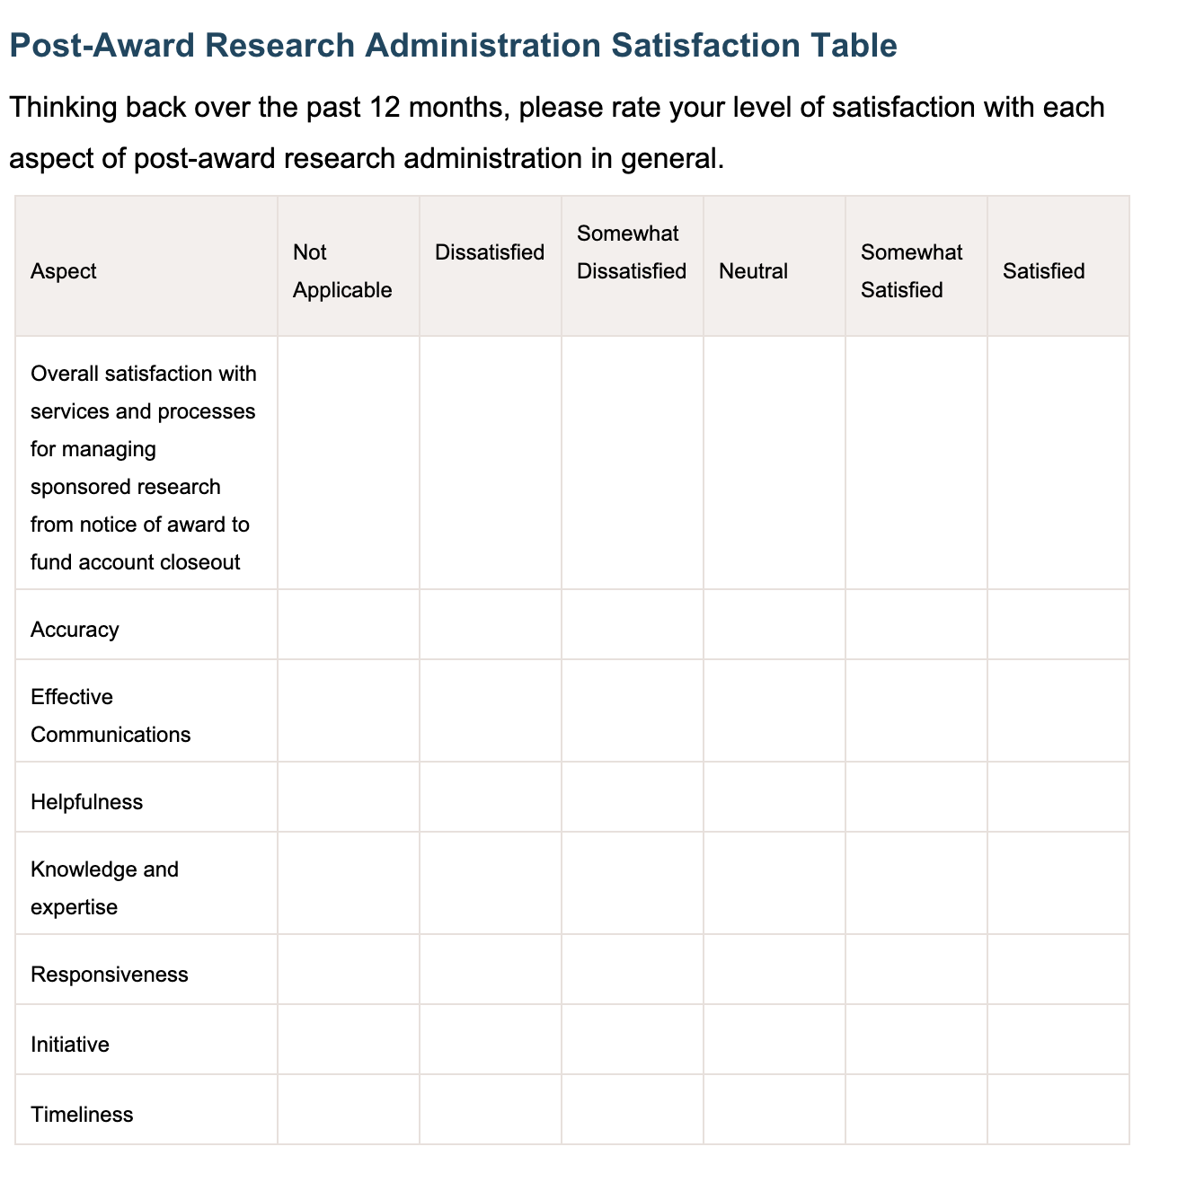
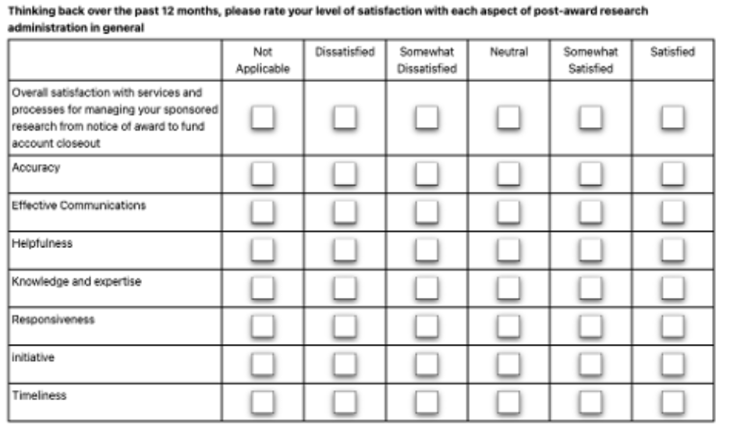
Improving Appearance of Statistical/ Financial Software Output
Make the image into a table that I can edit with Word. Output as an editable word document
Notes:
Now I will let you know how really ancient I am – before we had personal computers, before I was a professor, when I was working as an engineer, we would send material down to the typing pool where there were specific machines for word processing and someone would type these up.

Slide 35
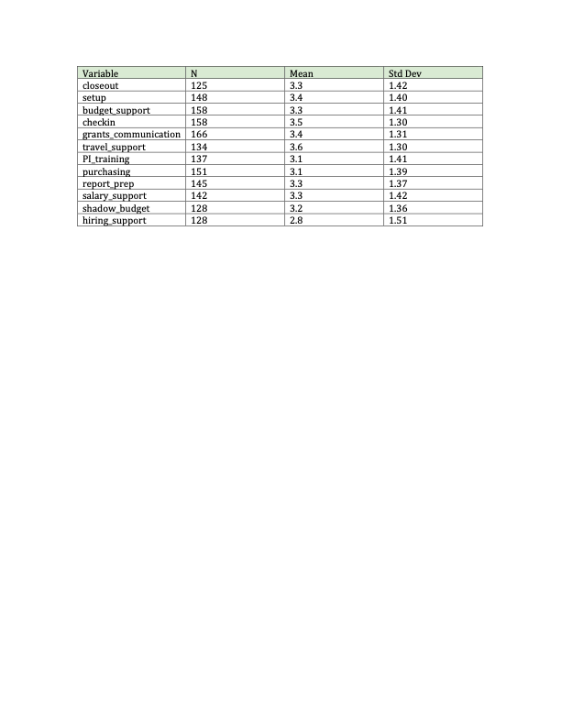
Improving Appearance of Statistical/ Financial Software Output
Variable | N | Mean | Std Dev | Minimum | Maximum
closeouta setupa budget_supporta checkina grants_communicationa travel_supporta PI_traininga purchasinga report_prepa salary_supporta shadow_budgeta hiring_supporta | 125 148 158 158 166 134 137 151 145 142 128 128 | 3.3360000 3.4054054 3.3354430 3.4683544 3.4096386 3.6119403 3.0583942 3.0529801 3.3034483 3.2535211 3.1796875 2.8437500 | 1.4195865 1.4037745 1.4079427 1.3049191 1.3122836 1.2972524 1.4129986 1.3942170 1.3709493 1.4213999 1.3599073 1.5081798 | 1.0000000 1.0000000 1.0000000 1.0000000 1.0000000 1.0000000 1.0000000 1.0000000 1.0000000 1.0000000 1.0000000 1.0000000 | 5.0000000 5.0000000 5.0000000 5.0000000 5.0000000 5.0000000 5.0000000 5.0000000 5.0000000 5.0000000 5.0000000 5.0000000
Notes:
Whether it is for an article for publication, a grant application or a report to upper management, I wasted an inordinate amount of time, typing statistics into documents to look nicer. You could spend a lot of time formatting tables with SAS or R code to get the same result, but, seriously, why would you?

Slide 36
Improving Appearance of Statistical/ Financial Software Output
Variable | N | Mean | Std Dev | Minimum | Maximum
closeouta setupa budget_supporta checkina grants_communicationa travel_supporta PI_traininga purchasinga report_prepa salary_supporta shadow_budgeta hiring_supporta | 125 148 158 158 166 134 137 151 145 142 128 128 | 3.3360000 3.4054054 3.3354430 3.4683544 3.4096386 3.6119403 3.0583942 3.0529801 3.3034483 3.2535211 3.1796875 2.8437500 | 1.4195865 1.4037745 1.4079427 1.3049191 1.3122836 1.2972524 1.4129986 1.3942170 1.3709493 1.4213999 1.3599073 1.5081798 | 1.0000000 1.0000000 1.0000000 1.0000000 1.0000000 1.0000000 1.0000000 1.0000000 1.0000000 1.0000000 1.0000000 1.0000000 | 5.0000000 5.0000000 5.0000000 5.0000000 5.0000000 5.0000000 5.0000000 5.0000000 5.0000000 5.0000000 5.0000000 5.0000000
Convert this data to a Word file in the following format - Each value in the variable column should be a separate cell in the variable column. Delete the letter “a” at the end of each variable name. Each number in the N column should be a separate cell. Each number in the mean column should be a separate cell and the number rounded to the nearest decimal (tenths place) each number in the Std Dev column should be a separate cell and the number rounded to the nearest hundredth. output as a Word table with four columns (Variable, N, Mean, Std Dev) Use grid+shading.
Notes:
Note that I have to convert data like this A LOT, so I can use this same prompt with a little modification

Slide 37

Key take-aways
On simple, clerical tasks, generative AI performed with nearly 100% accuracy in the task assigned. However, it did not go beyond that task like a human intern would, for example, noticing that some articles did not have page numbers.
Save your useful prompts

Slide 38
AI Tutor
AI-powered research assistants (Gemini Notebook, Copilot notebook). Sources can be documents, videos, or links provided by the user.
Examples
  Internal documentation for a grant that can answer questions on performance to objectives, evaluation tasks, and other evaluation-related issues.
  Used by a project coordinator to determine average maintenance cost for specific high-cost piece of scientific equipment.
  Creation of instructional videos for staff training on research administration.
Caveats:
  Organizational accounts limit sharing notebooks with external users.
  Notebooks are only as effective as the sources provided — garbage in, garbage out.
Notes:
Gemini Notebook (formerly NotebookLM) and Copilot Notebook are source-grounded AI-powered research assistants. Sources can be documents, videos, or links provided by the user. Example uses include:
Internal documentation for a grant that can answer questions on performance to objectives, evaluation tasks, and other evaluation-related issues.
Used by a project coordinator to determine average maintenance cost for specific high-cost piece of scientific equipment.
Creation of instructional videos for staff training on research administration.
Caveat: Organizational accounts limit sharing notebooks with external users. Gemini Notebook and Copilot Notebook are only as effective as the sources provided — garbage in, garbage out. Human review of all AI-generated training content is mandatory.

Slide 39

Human-in-the-loop required
Tasks for which AI produces an unacceptable level of error without substantial review, but, with such review, can save time and improve results.
Example: Brainstorming” using retrieval augmented generation - A proposal final draft is uploaded to Gemini PRO, including a link to the request for proposal and a prompt to suggest 12 additional topics
Notes:
These are tasks for which AI produces an unacceptable level of error without substantial review, but, with such review, can save time and improve results. As someone who reviews grants, I am BEGGING you, please do not submit a grant proposal written with AI. It is NOT fundable and wastes the reviewers’ time.
“Brainstorming” using retrieval augmented generation
A proposal final draft is uploaded to Gemini PRO, including a link to the request for proposal and a prompt to suggest any additional topic
Gemini Pro was used at one institution because the paid version does not use prompts and data uploaded for training. As best practice, however, all confidential and personally identifying information was removed prior to uploading. Testing to date has determined this usage to be recommended only with a “human in the loop”. Less than 20% of recommendations were usable.
[Visual source: AI-generated conceptual pictogram, added for illustration. Not a factual depiction.]

Slide 40

Application of Generative AI to Research Administration Across Institution Types
At smaller institutions, like many tribal colleges and universities , sponsored research may be one person, or 25% of two people’s jobs, and they are doing everything they can to assist the principal investigator
Notes:
I am going to briefly pause from examples here because I know that my next few examples could raise some objections – wait a minute, that’s not research administration, or sponsored programs office doesn’t do that. If you work at a large institution, like the University of South Florida, I am sure that is true. However, at smaller institutions, like many tribal colleges and universities , sponsored research may be one person, or 25% of two people’s jobs, and they are doing everything they can to assist the principal investigator.
[Visual source: AI-generated conceptual pictogram, added for illustration. Not a factual depiction.]

Slide 41
Writing the proposal
Creating graphics based on documents provided
Initial database search for literature
  Context: A faculty member is planning research that will use software to analyze qualitative data. The faculty member is doing sociological research.
  Prompt: Find 25 references from the last ten years on the topic of qualitative analysis software and, based on these references, make your top two recommendations and give reasons for the recommendations. INCLUDE LINKS. Include any articles that compare two or more programs. Do not include any programs that are specific to an area that does not relate to sociology. For example, do not include software specifically designed to analyze health records.
Notes:
Creating graphics based on documents provided with claude or copilot and automatically added to a Word file for a proposal or Powerpoint (like for presentations like this to faculty or at conferences)
Initial database search for literature
Again, this is the type of thing that in the old days, I would send an intern to the library to do. Now, I use Gemini Deep Research.
For intern or AI
Context: A faculty member is planning research that will use software to analyze qualitative data. The faculty member is doing sociological research.
Prompt: Find at least 25 references from the last ten years on the topic of qualitative analysis software and, based on these references, make your top two recommendations and give reasons for the recommendations. INCLUDE LINKS. Include any articles that compare two or more programs. Do not include any programs that are specific to an area that does not relate to sociology. For example, do not include software specifically designed to analyze health records.

Slide 42
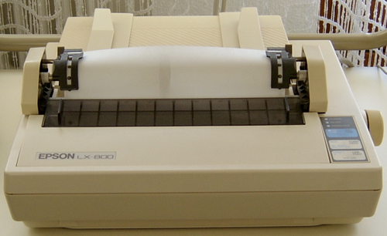
Step 2
Ignore the references that are clearly irrelevant
Click on the links, download and read (yes, the whole article, not just the abstract) the ones that are linked as supporting a specific recommendation.
This Photo by Unknown Author is licensed under CC BY-SA
Notes:
I want to highlight initial here. Once Deep Research returns a report, I do almost exactly what I did back in the day when a student would come back with a list of articles printed out from a dot matrix printer. I ignore the references that are clearly irrelevant and then click on the links, download and read (yes, the whole article, not just the abstract) the ones that are linked as supporting a specific recommendation.

Slide 43

AI can be an efficient START
AI has advantages over a human researcher in speed and breadth in retrieval of references
For contextual analysis, consistency and transparency of methods, the human researcher was superior. The review produced by AI could be too broad, with articles of minimal relevance included.
Notes:
For any kind of literature review, AI can be an efficient start. Our results have been consistent with Mostafapour et al. (2024) who found AI to have advantages over a human researcher in speed and breadth in retrieval of references, however, for contextual analysis, consistency and transparency of methods, the human researcher was superior. The review produced by AI could be too broad, with articles of minimal relevance included. We agree with Mostafapour et al. that, far from having Ph.D. level expertise, AI more resembles an intern or research assistant, with surface level knowledge of a topic.
[Visual source: AI-generated conceptual pictogram, added for illustration. Not a factual depiction.]

Slide 44

I love open source models
Download ollama from https://ollama.com/
From the terminal window type ... ollama run llama3.2 “Enter the prompt”
Notes:
Using private local open-source models
There is a lot of talk about using open source local models because all of the data stays on your local machine, that is, your personal computer. How do you do it?
Local models in two steps
One simple way is to use ollama
Download ollama from https://ollama.com/
From the terminal window type ... ollama run llama3.2 “Enter the prompt”
The first time you invoke a model, it will be downloaded and installed. The example above uses llama3.2 but there are many models available that you can see at the ollama site.
[Visual source: AI-generated conceptual pictogram, added for illustration. Not a factual depiction.]

Slide 45
Use models to return information from specific information on your computer
ollama run llama3.2 "Use /Volumes/Backup/data4models/nsf23_1.pdf to list the requirements for SBIR grants from NSF. Include page limits, font-size, organization eligibility and any other requirements you find. Include the page numbers where you find each requirement"
Notes:
You can use models to return information from specific information on your computer, for example,
ollama run llama3.2 "Use /Volumes/Backup/data4models/nsf23_1.pdf to list the requirements for SBIR grants from NSF. Include page limits, font-size, organization eligibility and any other requirements you find. Include the page numbers where you find each requirement"

Slide 46
1. Page Limits: The total number of pages in the final report, including all appendices, must not exceed 30 pages.
2. Font-Size: The font size used in the final report is limited to 12-point Times New Roman for body text and 18-point Times New Roman for
titles.
Organization Eligibility:
3. Sole Proprietorships: NSF allows sole proprietorship applications under SBIR, but requires a minimum of 40% of gross income from
non-SBIR sources (Page 2).
4. Limited Liability Companies (LLCs): NSF allows LLCs as eligible organizations, with the requirement that the LLC's tax ID number must
be listed on the Fast track or regular SBIR application cover page (Page 5).
5. Small Business Concerns: The organization must meet one of the following criteria:
a. Less than 100 employees (Small business concern)
b. $7 million in annual gross revenues (Systematically small concern)
c. Less than $4.25 million in annual federal procurement contracts ( Systematically small concern) (Page 6)
Notes:
Produces this response a and a whole lot more
I've accessed the PDF file you provided and extracted the requirements for SBIR (Small Business Innovation Research) grants from NSF. Here are the requirements I found:

Slide 47

Saving space
install the models on an external drive so that these don’t take up all of the space on your hard drive.
mv ~/.ollama/models /Volumes/Backup/ollama_models
ln -s /Volumes/Backup/ollama_models ~/.ollama/models
The first command moves the models. The second creates a symbolic link that points to this location when ollama is started
Notes:
Some tips – if you are going to run multiple models, you may want to install the models on an external drive so that these don’t take up all of the space on your hard drive.
mv ~/.ollama/models /Volumes/Backup/ollama_models
ln -s /Volumes/Backup/ollama_models ~/.ollama/models
The first command moves the models. The second creates a symbolic link that points to this location when ollama is started
You’d only need to do this if your computer does not have a lot of free disk space
[Visual source: AI-generated conceptual pictogram, added for illustration. Not a factual depiction.]

Slide 48

The Bad
Larger models can take up a lot of space. Combining a model on an external drive with a computer that doesn’t have a lot of RAM
  Your AI results can be really slow
  While the AI model is running, it can slow down other tasks as well
A computer that costs hundreds of dollars with <12GB of RAM is going to be slow
Notes:
The Bad
Why did I suggest moving the models? Because larger models can take up a lot of space. The downside of that is that if you combine a model on an external drive with a computer that doesn’t have a lot of RAM, your AI results can be really slow and, if this is your desktop computer, while the AI model is running, it can slow down other tasks noticeably as well.
[Visual source: AI-generated conceptual pictogram, added for illustration. Not a factual depiction.]

Slide 49
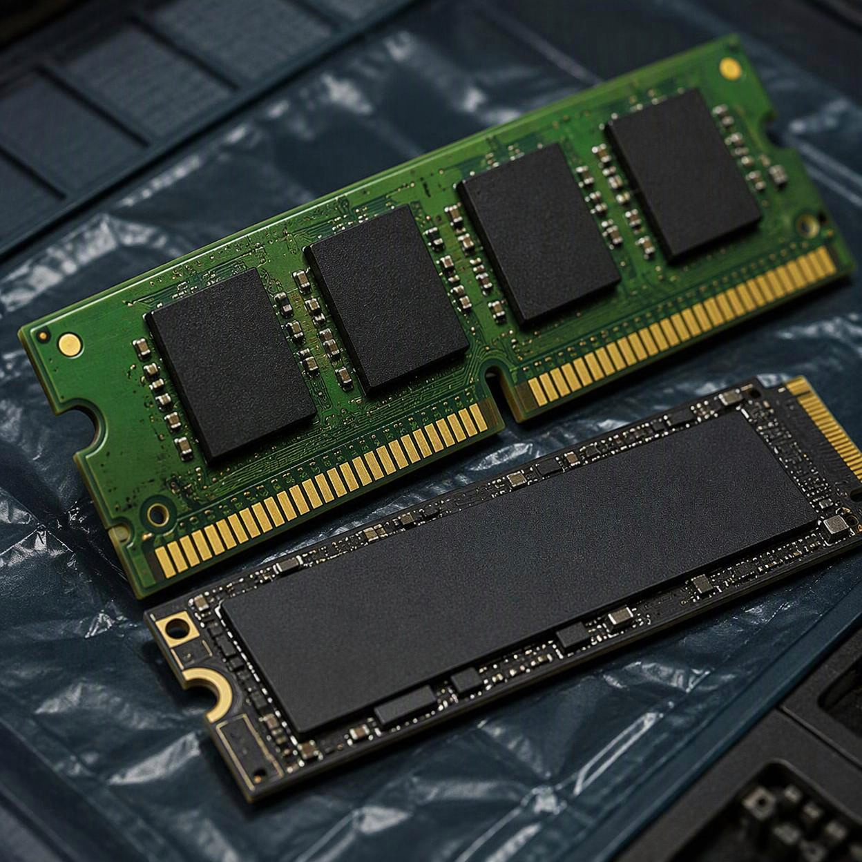
The Good?
24GB of RAM and 1TB of internal storage will run most models reasonably fast
Notes:
I have two computers, one has 12GB of RAM and has the models on an external drive. The other has 24GB RAM and the models are saved on the internal disk drive. Both run llama3.2 well. The computer with the smaller RAM and external drive is really slow. That’s the bad news. The good news is that you don’t need to spend a fortune to get a usable setup, but it’s more likely to cost you thousands than hundreds to get a computer with a minimum of 24GB RAM and 1TB of internal storage.
[Visual source: AI-generated conceptual pictogram, added for illustration. Not a factual depiction.]

Slide 50
Three major issues with AI
Data security breaches - When faculty or staff upload proposals to non-secure AI applications,
Inappropriate application of AI - Gemini Deep Search results being pasted directly into grant proposals
  Result: proposals are redundant and lacking in specific details
Hallucinations - reports were those that were factually incorrect
  For every prompt, add “include link to sources” , verifying that those sources exist, and support the statement.
  For code, run the code and validate the results.
Notes:
These uses have not been problem-free. Three major issues identified are data security breaches, hallucinations and inappropriate application of AI. When faculty or staff upload proposals to non-secure AI applications, these data are used for training and proprietary information, such as staff salaries or preliminary research results, may be made publicly available. The last two issues are correlated. Instances have occurred of Gemini Deep Search results being pasted directly into grant proposals. Not only does this often violate agency requirements, but the quality is lower than a human-written proposal. Contrary to corporate claims that AI is equivalent to “a Ph.D. in everything”, these proposals tended to be redundant and lacking in specific details, for example, referring to “AI” rather than a specific model or “Native American” instead of the tribal nation where research would be conducted. Of greater concern than low-quality proposals or reports were those that were factually incorrect. For every prompt, we recommend adding “include link to sources” and then verifying that those sources do, in fact, exist, and support the statement. For code, run the code and validate the results.

Slide 51

Inappropriate use of AI: Example
Accessing university sharepoint files and subverting the restrictions placed on a student account by downloading files on to a personal desktop and running a Visual Basic application to analyze these files.

Slide 52
The “sort of good”
On the average, PIs and research administrators experienced saving an average of 5-15% of their time per week.
Still, time savings are significant across time and multiple personnel, freeing resources to focus on research or more complex research administration task
AI has demonstrated the greatest time savings when tasks were simpler, which can be achieved by breaking complex tasks into small steps
More experienced staff, whether software developers or research administrators, benefit more by using AI because they can identify and fix errors that less experienced staff miss.
Notes:
While generative AI models have increased productivity when appropriately applied, these have by no means proven a replacement for research administrators. On the average, PIs and research administrators experienced saving an average of 5-15% of their time per week. Still, time savings are significant across time and multiple personnel, freeing resources to focus on research or more complex research administration task
Two important points - 1. AI has demonstrated the greatest time savings when tasks were simpler, which can be achieved by breaking complex tasks into small steps and 2. More experienced staff, whether software developers or research administrators, benefit more by using AI because they can identify and fix errors that less experienced staff miss.

Slide 53

Uses we observed are not the only uses
Example, Auburn University uses an AI-driven platform to facilitate collaboration of researchers across disciplines
Notes:
We do not want to leave the impression that these are the only uses of AI in research administration. These are the areas that we personally have been involved in implementing and can comment based on observation of the benefits and pitfalls. There are other uses. For example, Auburn University uses an AI-driven platform to facilitate collaboration of researchers across disciplines (McAdory, 2025). A recent search on the platform on the term “epidemiology”, yield 20 results from disciplines as diverse as the College of Agriculture, College of Engineering, Auburn University Libraries and the College of Sciences and Mathematics. It appears that this may be a very valuable use but we cannot speak to it from experience.
[Visual source: AI-generated conceptual pictogram, added for illustration. Not a factual depiction.]

Slide 54

The Ugly
Many have become over reliant on the tool, unaware of the mistakes it can bring and taking everything it produces as truth.
Users need to understand that LLM will “confidently produce false, misleading, or fabricated information”
Notes:
The Ugly
The popularity of AI has skyrocketed since the ChatGPT model was released in late 2022. The use of the model turned AI from backend technology to a tool that many use to write text, create images, create computer code, and scripts. The ugly part is that many have become over reliant on the tool, unaware of the mistakes it can bring and taking everything it produces as truth. Users need to understand that LLM will “confidently produce false, misleading, or fabricated information” (8 AI Hallucinations Examples, 2026), known as “AI Hallucinations”.
[Visual source: AI-generated conceptual pictogram, added for illustration. Not a factual depiction.]

Slide 55
Hallucinations
AI hallucinations are "instances where an AI system produces outputs that sound plausible but are factually wrong, irrelevant, or entirely fabricated"
LLM and generative AI (gen AI) tools will search their outputs and predict the next token in the sequence based on patterns
If unable to find factual, credible data, it will present invented data, incorrect details and will go as far as creating URLS that do not exist and present them as factual outputs.
Notes:
AI hallucinations are defined as "instances where an AI system produces outputs that sound plausible but are factually wrong, irrelevant, or entirely fabricated" (China, 2026). LLM and generative AI (gen AI) tools will search their outputs and predict the next token in the sequence based on patterns and if the tools are unable to find factual, credible data, it will present invented data, incorrect details and will go as far as creating URLS that do not exist and present them as factual outputs.

Slide 56
AI and Native Americans
If the model does not have correct information, it will fabricate it.
Years ago, when first prompted, ChatGPT gave ten teachings, while the correct information was the Seven Grandfather Teachings. This has been resolved by end users supplying the correct information.
Notes:
When researching Native American facts using AI, it has been reported that if the model does not have correct information, it will fabricate it. Since LLMs are trained in collecting huge amounts of data, if the LLM does not have the answer, it will use predictive guesswork to create a response. One example of this is when ChatGPT was asked about the Anishinaabe Grandfather teachings. When first prompted, ChatGPT gave ten teachings, while the correct information was the Seven Grandfather Teachings. This has been resolved by end users supplying the correct information. While searching three separate LLMs, it all gave the correct information as of September 16th, 2026.

Slide 57
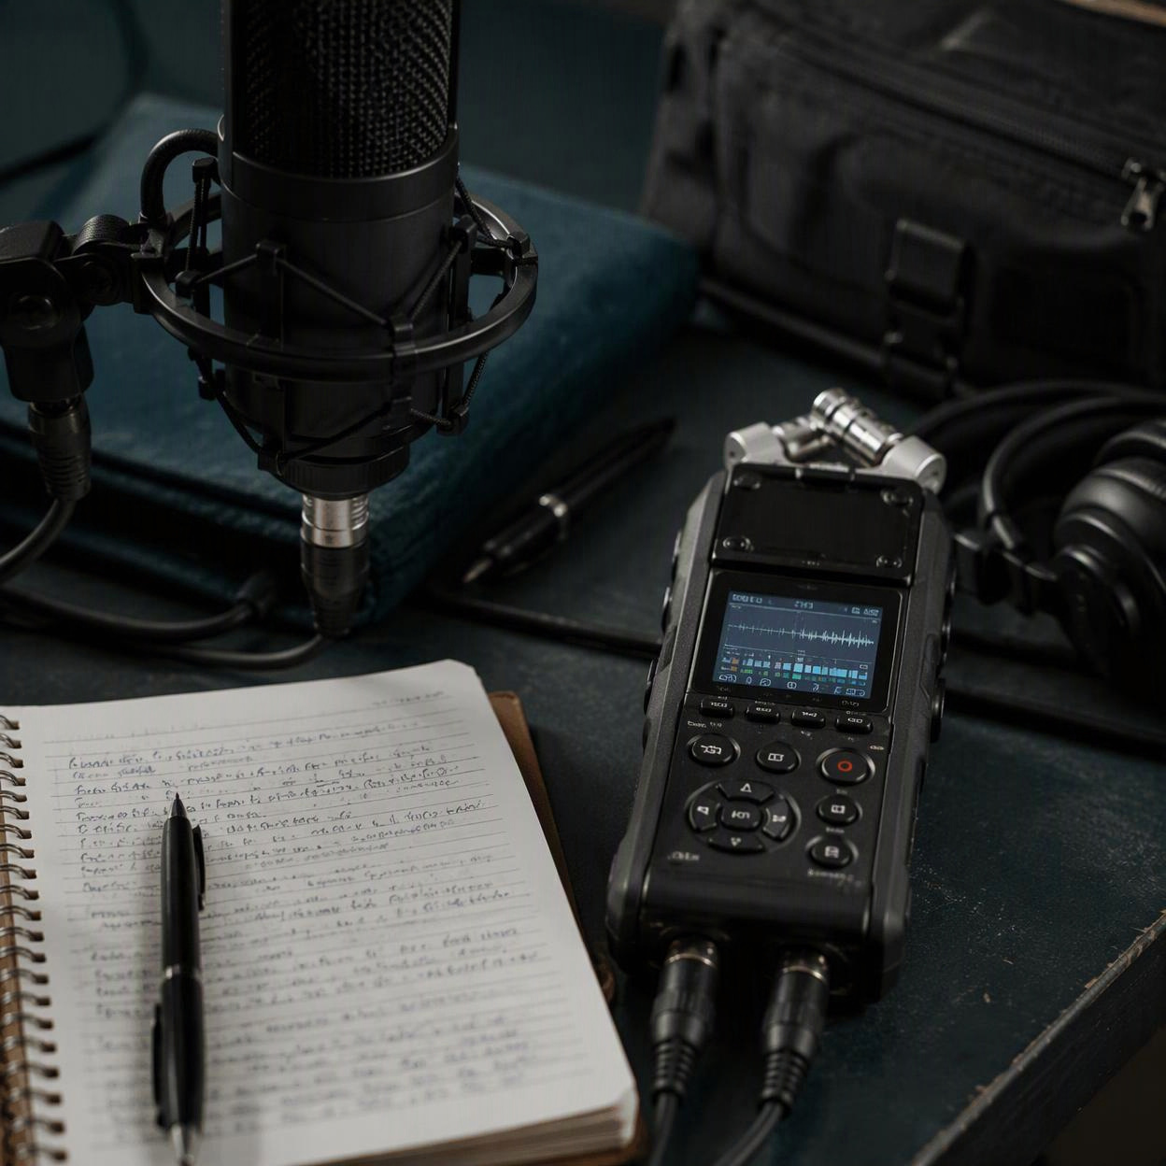
AI and Indigenous languages
"These systems are especially likely, given the limited datasets available for many Indigenous languages, to produce invented words, fabricated cultural teachings, or generalized 'pan-Indigenous' representations that flatten distinct nations or communities into one interchangeable identity" (Cbc, 2026)
Notes:
Language is another way that LLMs generate false information. "These systems are especially likely, given the limited datasets available for many Indigenous languages, to produce invented words, fabricated cultural teachings, or generalized 'pan-Indigenous' representations that flatten distinct nations or communities into one interchangeable identity" (Cbc, 2026). This type of information is hurting Indigenous language revitalization because AI is generating false information that people are taking as truth, not only in language and indigenous history, but also in the medical field.
[Visual source: AI-generated conceptual pictogram, added for illustration. Not a factual depiction.]

Slide 58
AI is a convincing liar
ChatGPT was able to "create a highly convincing medical article that is completely fabricated with limited effort from a human user in a matter of hours" (Májovský et al., 2023).
If professionals in the medical field are relying on AI to research past diagnoses and come across fabricated articles and make decisions on patients based on this information
Notes:
In a study done in early 2023, one that was focused on "investigating the capabilities of current AI language models in generating high-quality fraudulent medical articles" (Májovský et al., 2023). The study was done using ChatGPT as the LLM and the AI detection tool used was Scale. The principal findings showed that ChatGPT was able to "create a highly convincing medical article that is completely fabricated with limited effort from a human user in a matter of hours" (Májovský et al., 2023). If professionals in the medical field are relying on AI to research past diagnoses and come across fabricated articles and make decisions on patients based on this information!

Slide 59

Information input is not confidential
All language models save input and use it to generate responses for other users asking questions.
Confidential information that is input, could potentially be used to answer questions asked about the information that was input.
Notes:
One huge concern of AI is the fact that all language models save all input and use it to generate responses for other users asking questions. That means any confidential information that is input, could potentially be used to answer questions asked about the information that was input. An example of this is when Amazon warned its employees against sharing data with ChatGPT and a senior corporate counsel at Amazon "suggested employees follow the company's existing conflict of interest and confidentially policies because there have been "instances" of ChatGPT responses looking similar to internal Amazon data" (Kim, 2023).
[Visual source: AI-generated conceptual pictogram, added for illustration. Not a factual depiction.]

Slide 60

Impact of AI on employees & employment
Companies are replacing duties and, in some cases, full employees with AI.
This replacement is causing more work for the employees who remain. Companies are using AI-generated code, which looks perfect, but the code fails.
46% of developers distrust any AI created code because of the work it takes to fix mistakes
Notes:
Many companies are replacing duties and, in some cases, full employees with AI. Developers have been hit hard with this reality. However, this replacement is causing more work for the employees who remain. Companies are using AI-generated code, which looks perfect, but the code fails. AI not only gives failing code, it also cannot find the mistakes that are made to correct them In fact, it fails at such a high rate that 46% of developers distrust any AI created code because of the work it takes to fix mistakes Estañol (2026).
[Visual source: AI-generated conceptual pictogram, added for illustration. Not a factual depiction.]

Slide 61
AI use NOT AI over-reliance
"AI hallucinations"—plausible-sounding yet entirely fabricated information generated through predictive guesswork
Hallucinations create severe real-world harms,
  Undermining Indigenous language and cultural preservation through the creation of fake vocabulary and inaccurate cultural teachings,
  Threatening public health by generating convincing, fraudulent medical research.
Generative AI poses major data privacy risks
Corporate attempts to replace human workers with these tools often backfire, where failing AI-generated code increases workloads for remaining staff and drives widespread professional distrust.
Notes:
The rapid, widespread adoption of large language models (LLMs) has led to a dangerous over-reliance on tools that frequently produce "AI hallucinations"—plausible-sounding yet entirely fabricated information generated through predictive guesswork. This tendency to invent facts creates severe real-world harms, such as undermining Indigenous language and cultural preservation through the creation of fake vocabulary and inaccurate cultural teachings, while also threatening public health by generating convincing, fraudulent medical research. Beyond factual inaccuracies, generative AI poses major data privacy risks by storing user inputs that can inadvertently leak sensitive information in future responses. Ultimately, corporate attempts to replace human workers with these tools often backfire, as seen in the software development industry, where failing AI-generated code increases workloads for remaining staff and drives widespread professional distrust.

